Slide 1

If you can't define "good", you can't measure "good"?
Notes:
“If you can't define "good", you can't measure "good"?” This is a quote from a good friend of mine. We have to know what we are aiming for in order to put observability tools in place that measure our definition of good.

Slide 2
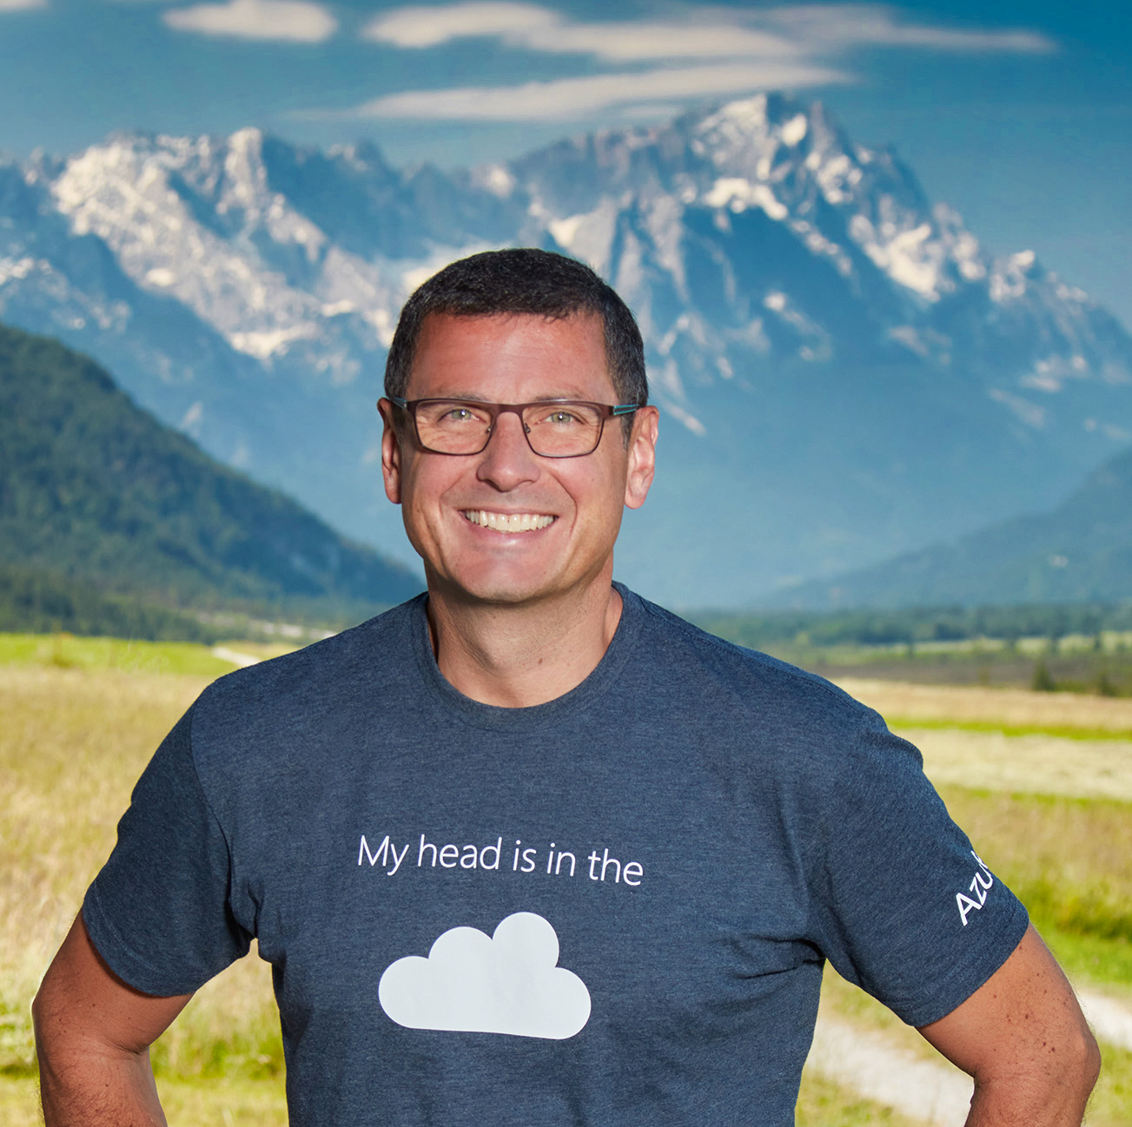
The Future of Observability:
Trends, AI, Vision
Harry Kimpel DevRel New Relic
@harrykimpel
Notes:
My name is Harry Kimpel, I work for New Relic and I would like to briefly talk to you about some aspects of the future of observability.
I will cover:
some of the current trends that we see in the industry
AI and a vision on what modern and the future of observability could look like
In order to cover these trends and challenges

Slide 3
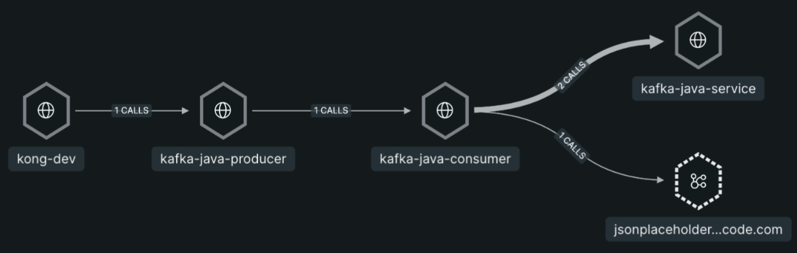
OpenTelemetry
Notes:
I am not here to tell you what OpenTelemetry is. This is Observability Day and I am pretty sure, everyone is aware of this open standard. I just wanted to point out a recent test environment I put in place. I used a local Kong hybrid API gateway that pointed to a Kafka sample app running in the cloud. A producer sending data into a local Kafka and a consumer receiving messages from Kafka.
I am in the software industry for quite some time now and if you ask me, this is still mind blowing! Having an end-to-end trace like this available without much effort.

Slide 4
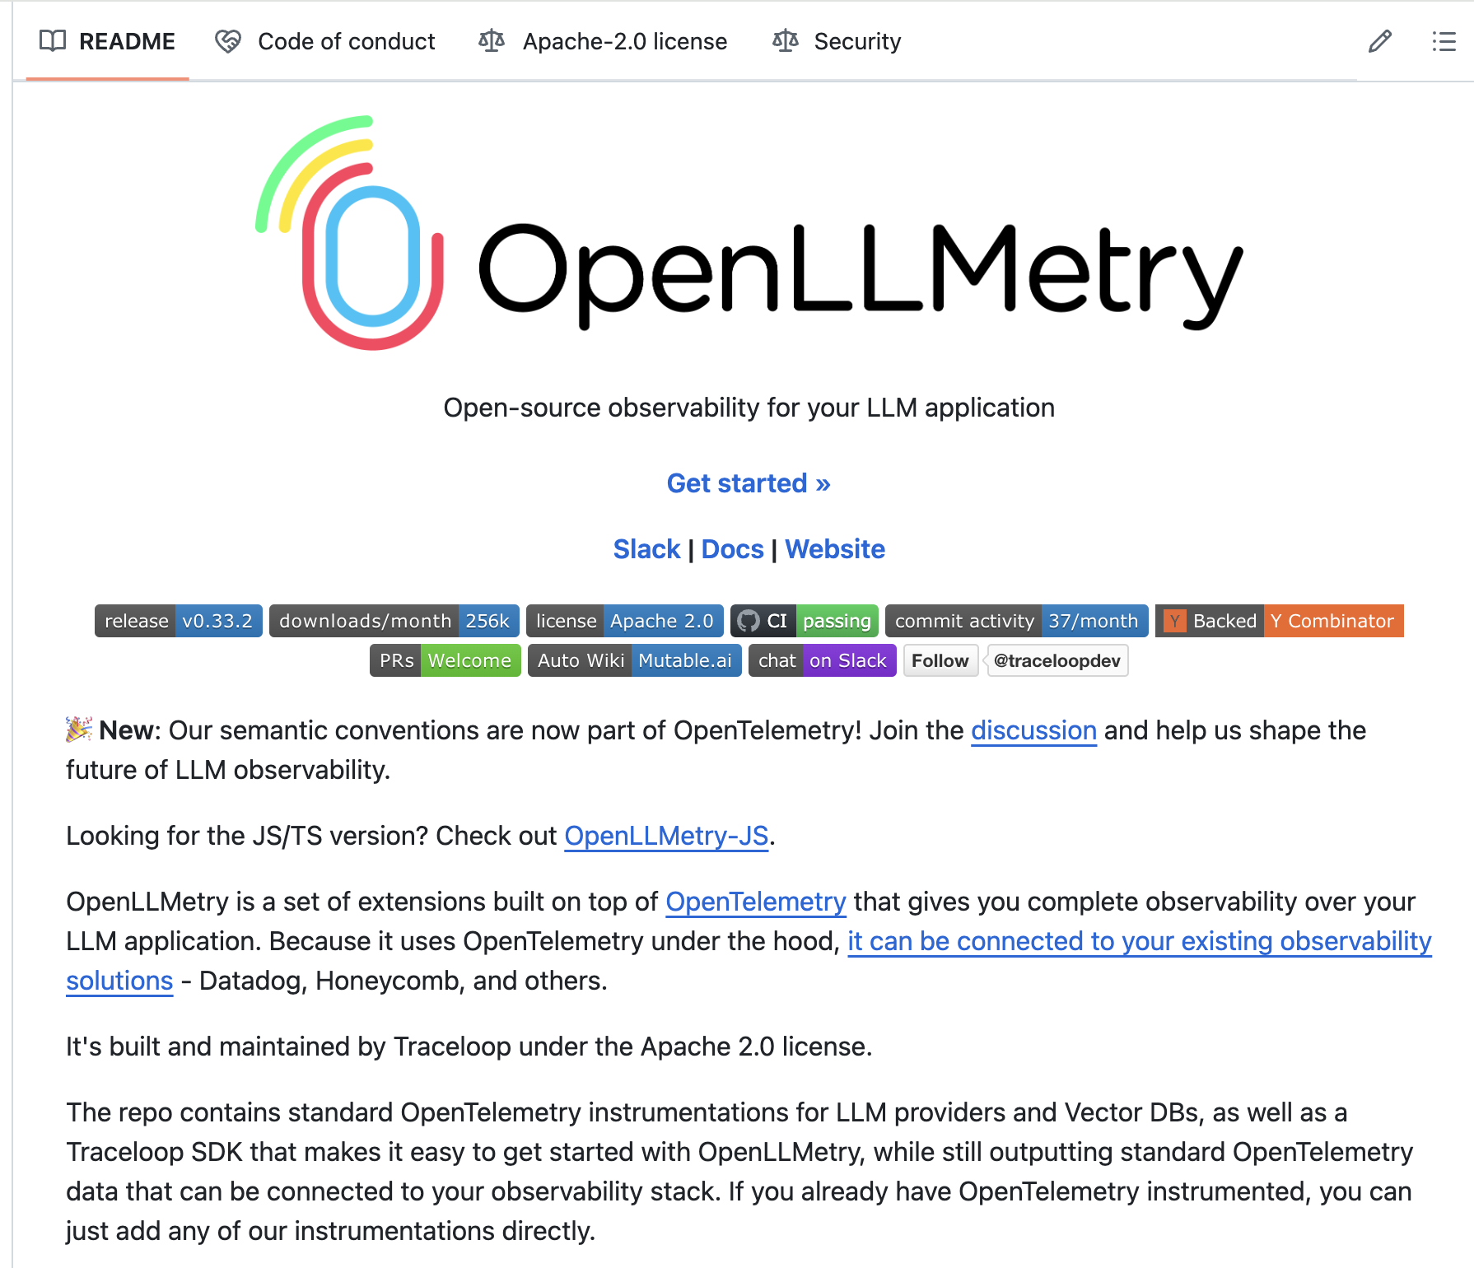
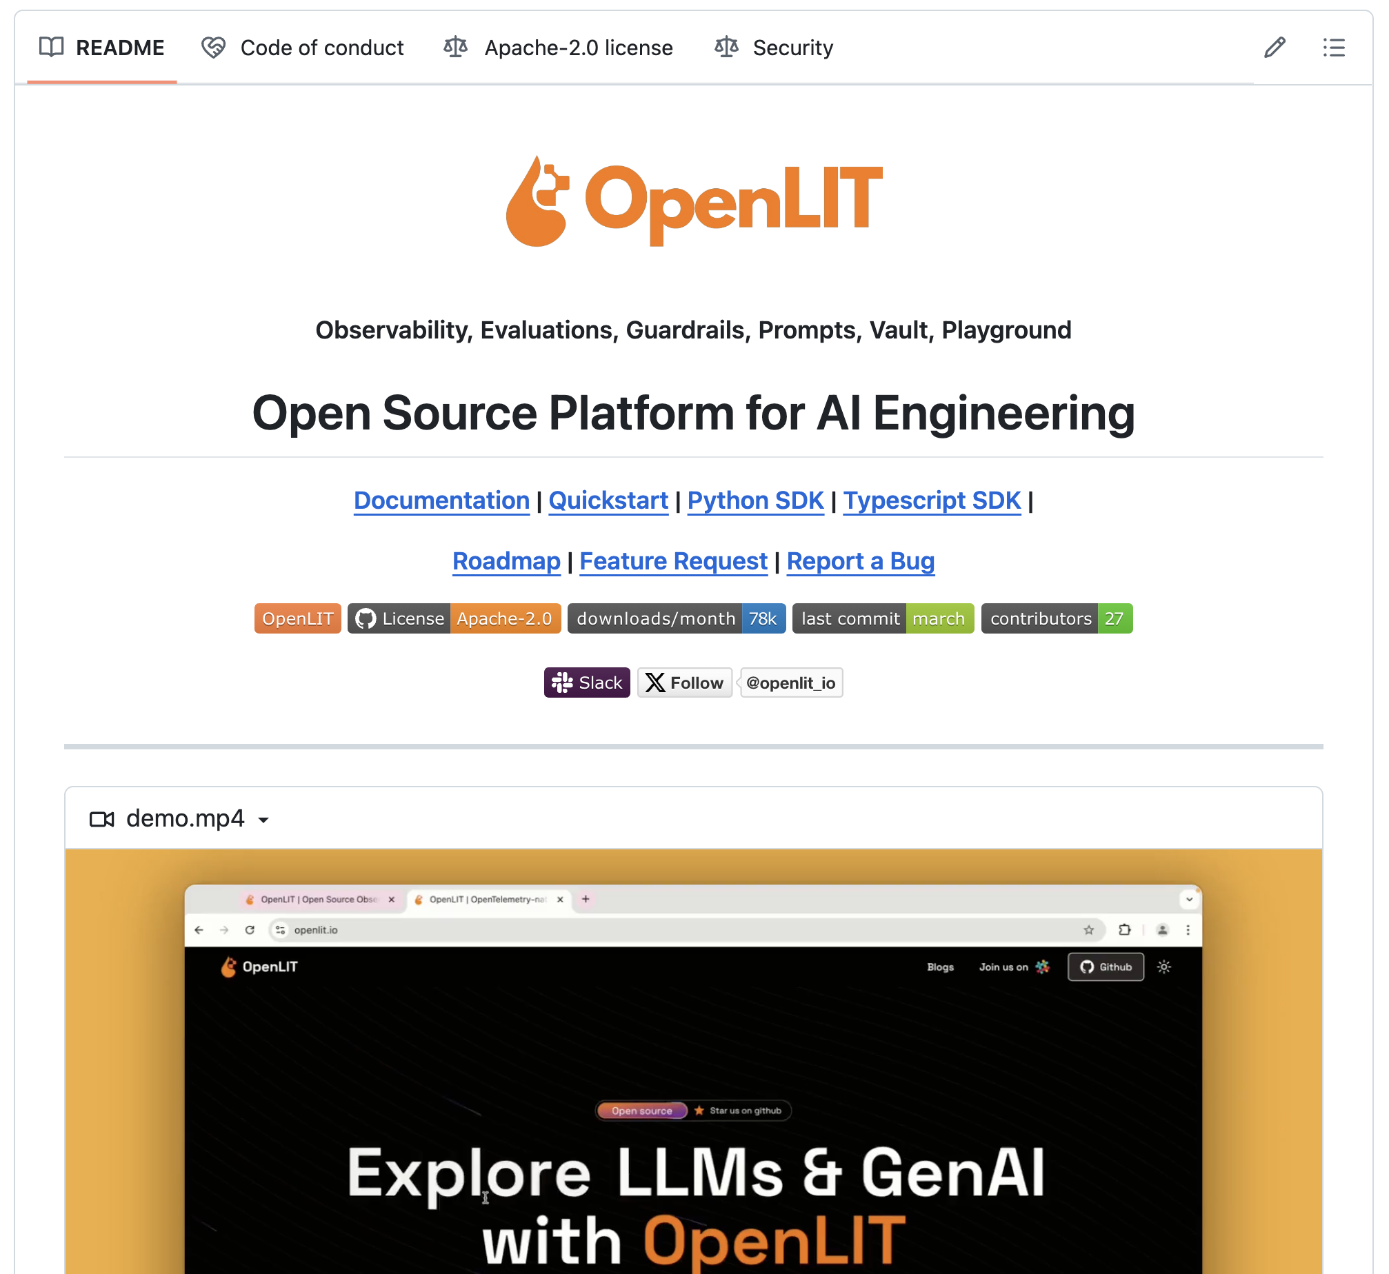
OpenTelemetry & GenAI
https://github.com/open-telemetry/community/blob/main/projects/gen-ai.md
https://github.com/traceloop/openllmetry
https://github.com/openlit/openlit
Arize Phoenix
Langfuse
LangSmith
Langtrace
Notes:
However, these days also generative AI and LLMs are a huge topic.
And … OpenTelemetry also has great potential today to target the challenges that come with integrating generative AI into your applications and landscape. You need to understand what models of your AI vendor of choice is best for the use case that you are targeting. New aspects to focus on are performance, cost and of course also the quality and sentiment of the responses from your model.
Examples of existing projects out there that I recently played with are OpenLLMetry and OpenLIT. They both cover various aspects of observing your generative AI applications. The features and capabilities of these projects are quite different though. And, there are even other projects out there that cover similar capabilities. Arize Phoenix, Langfuse, LangSmith and Langtrace for example.
The challenge today is however, that these capabilities are not yet standardized. I envision that OpenTelemetry will also come up with a dedicated standard around these aspects.

Slide 5
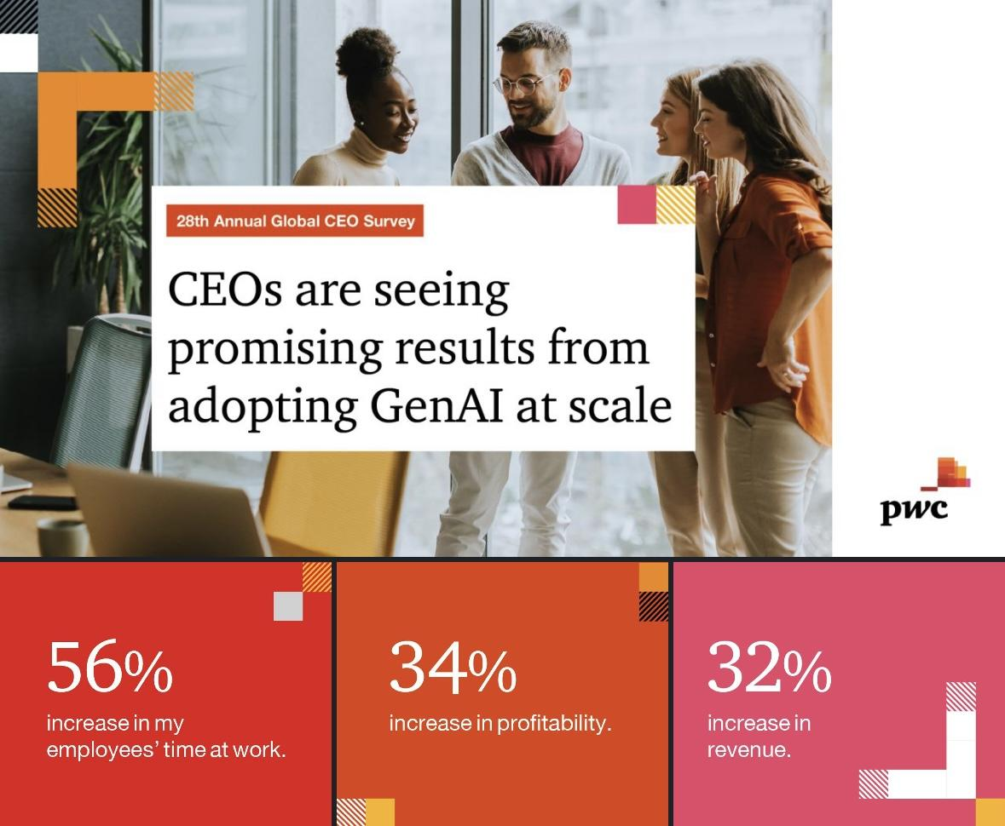
Impact of GenAI
Notes:
In a recent survey, PricewaterhouseCoopers asked global CEOs on their expectations on the impact of GenAI.
Around one-third of the CEOs told them that they expect increased revenue and profitability from leveraging GenAI.
Much more interestingly, especially for the audience in this room, is the fact that more than half of them report that GenAI results in efficiencies in how employees use their time at work
This is mind staggering. And this also brings me to the next aspect of my talk.

Slide 6
Developer Productivity
30%
Developer productivity
“If your team is not at least 30 times faster than it is today by 2030, you’re going to be on the street. Your job is gone! … Get ready to get unemployed!”
Jeff Sutherland
co-creator of Scrum
Azure & DevOps Podcast
Notes:
I recently listened to the Azure & DevOps Podcast. Jeffrey Palermo, the host of this podcast, had a discussion with Jeff Sutherland about the history of agile. At some point throughout the podcast, Jeff talked about the developer productivity. He mentioned that “If your team is not at least 30 times faster than it is today by 2030, you’re going to be on the street. Your job is gone! … Get ready to get unemployed!” This is a bold statement of course. However, it brings to our attention that we have to get more efficient in order to keep up with all the changes that are coming and the competition that is around us.

Slide 7
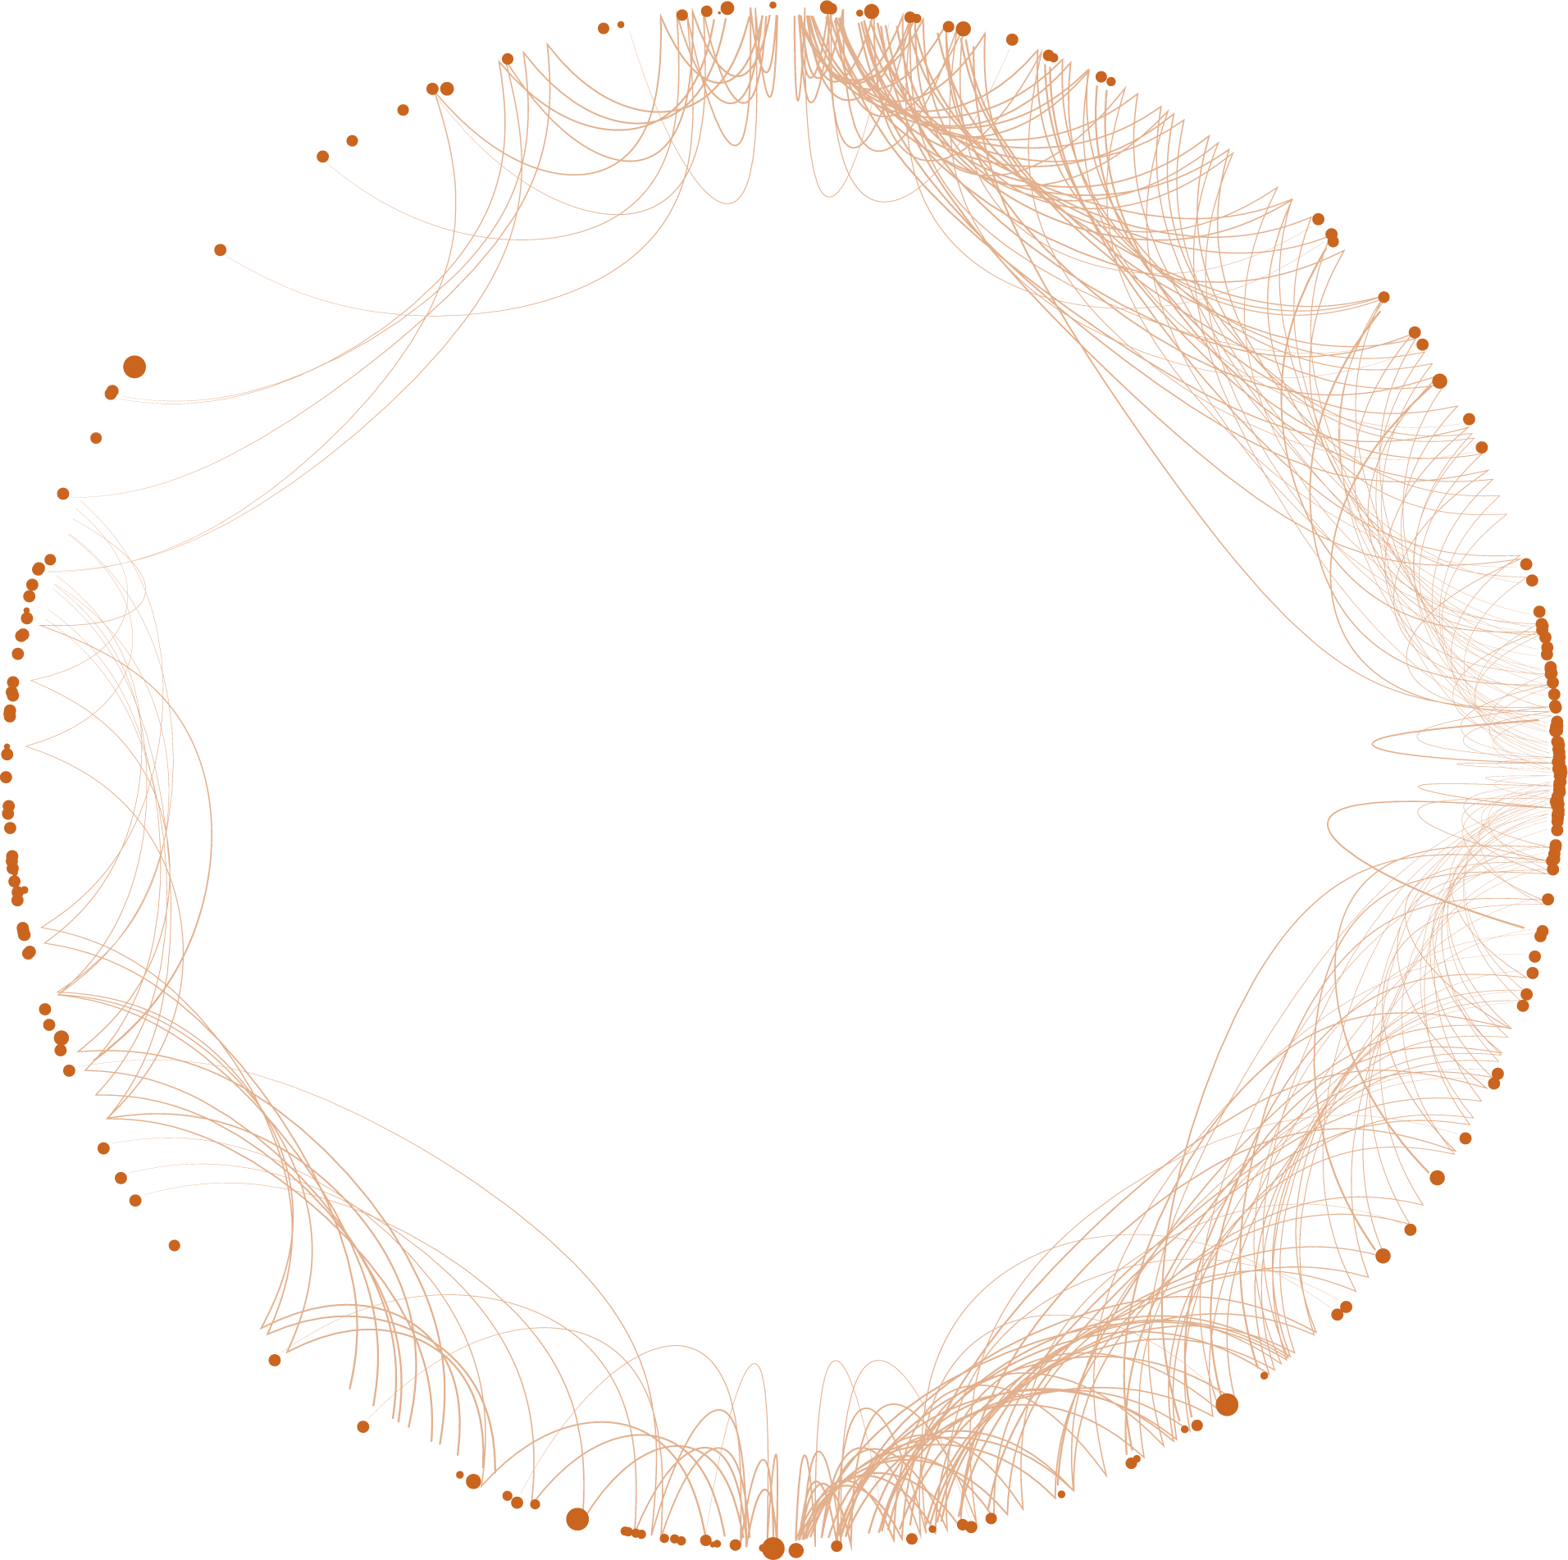
Agentic DevOps
IDE integrations
Intelligent roll-back management
Empower developers & SREs
AI-driven predictive analytics
Agentic
DevOps
Agent-to-agent architecture
Faster-path to remediation
Notes:
One of the ways I envision our productivity to get up in the world of observability specifically is the concept of Agentic DevOps. I think we can and should leverage dedicated agents that help us in our day to day jobs. As a software developer, I would like to have everything as close as possible to the environment that I am working. This should come with various IDE integrations in order to empower developers and SREs. Examples are agent-based integration into GitHub Copilot for example. But also intelligent roll-back management, AI driven predictive analytics and a faster-path to remediation. These agents could and should work in concert in an agent-to-agent architecture to make these things happen.

Slide 8
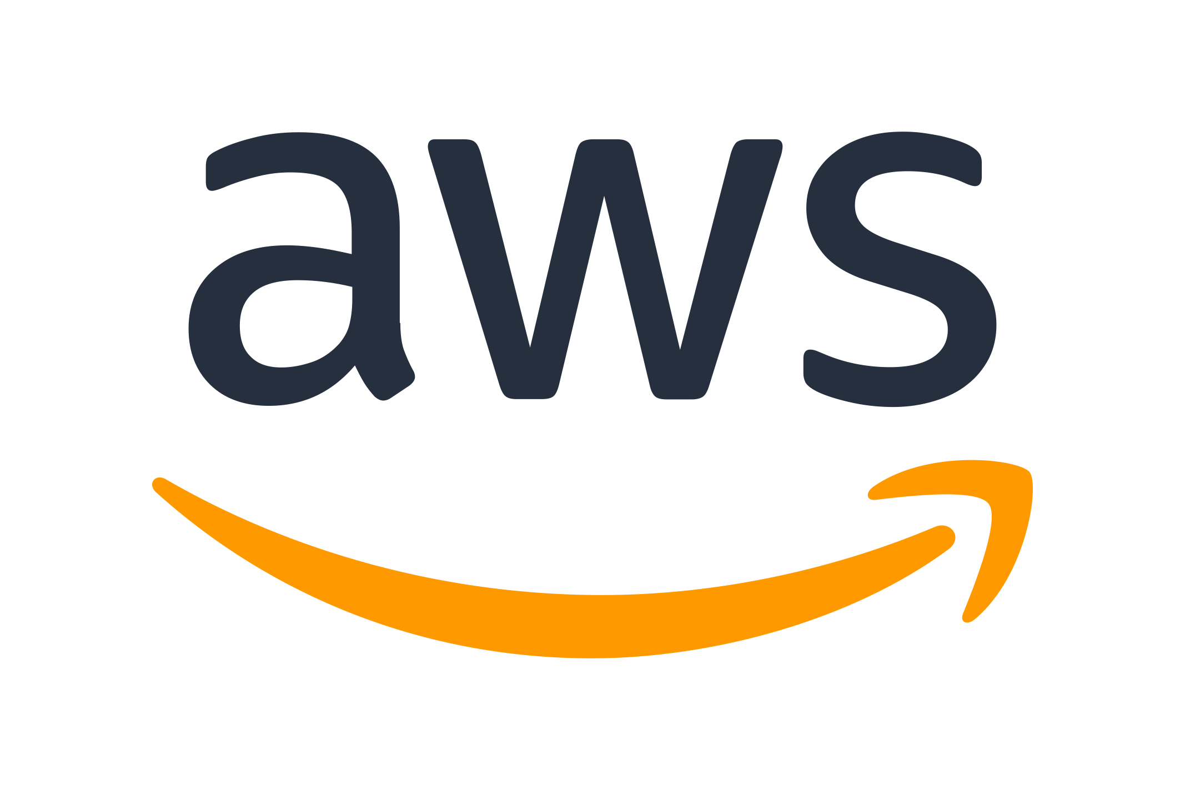

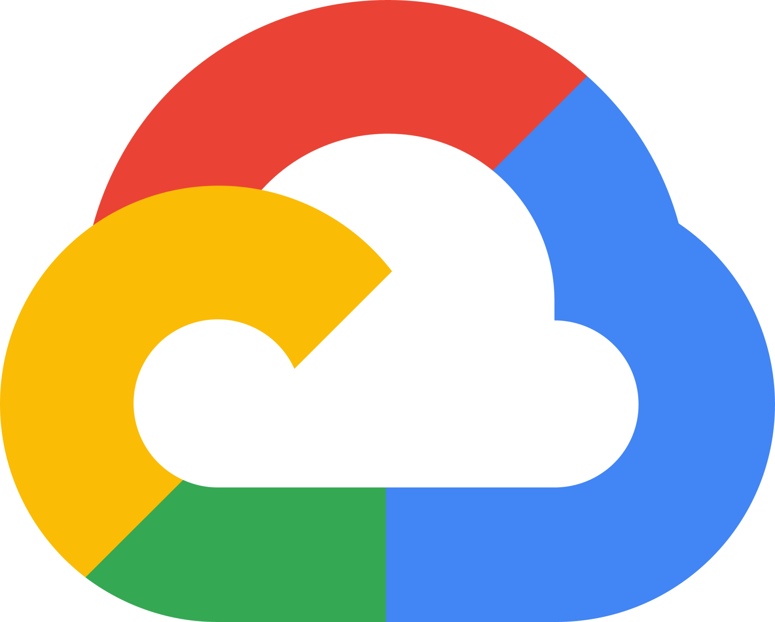




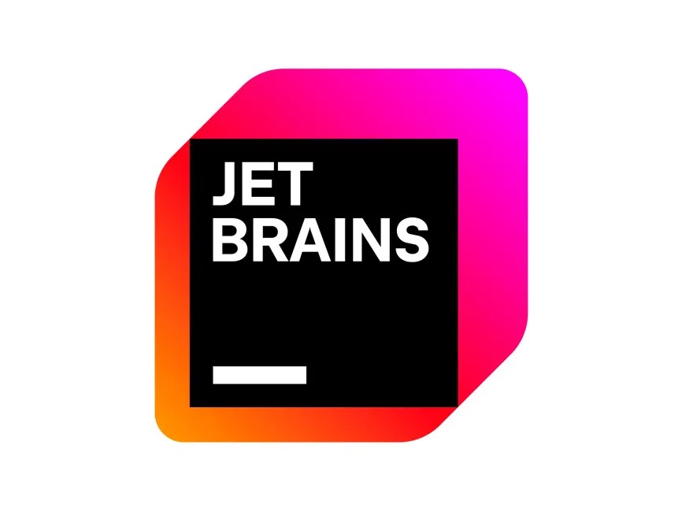

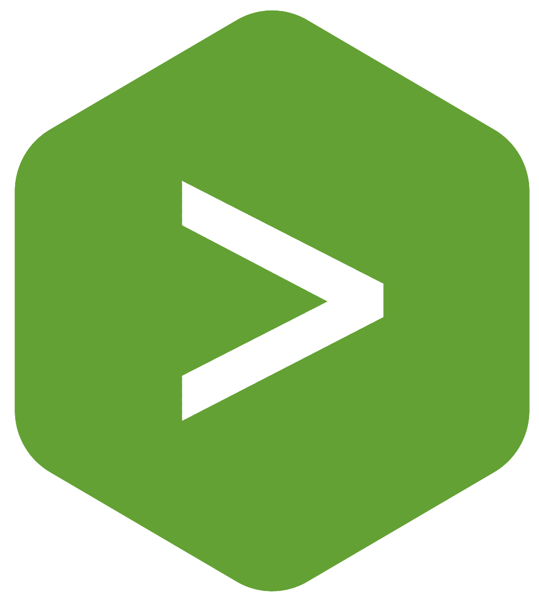











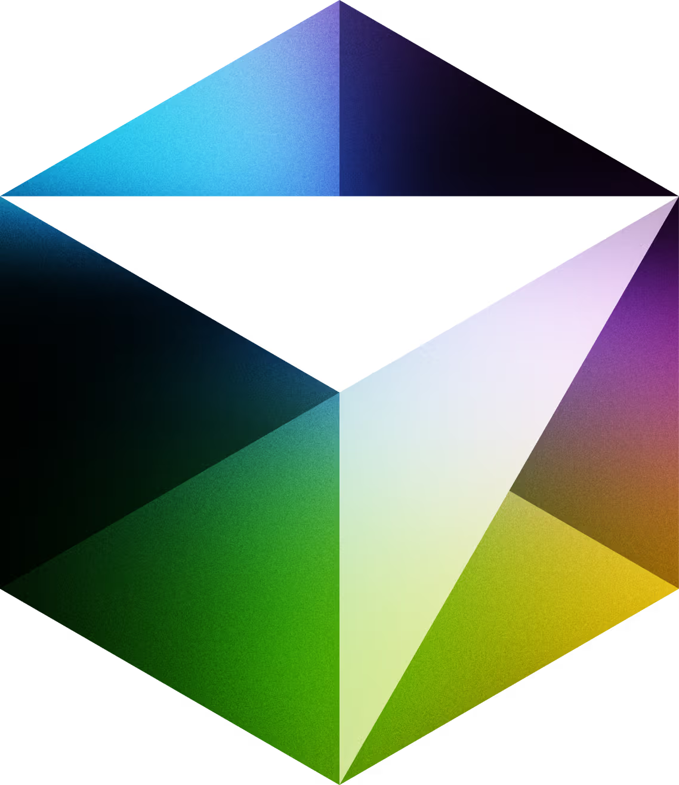
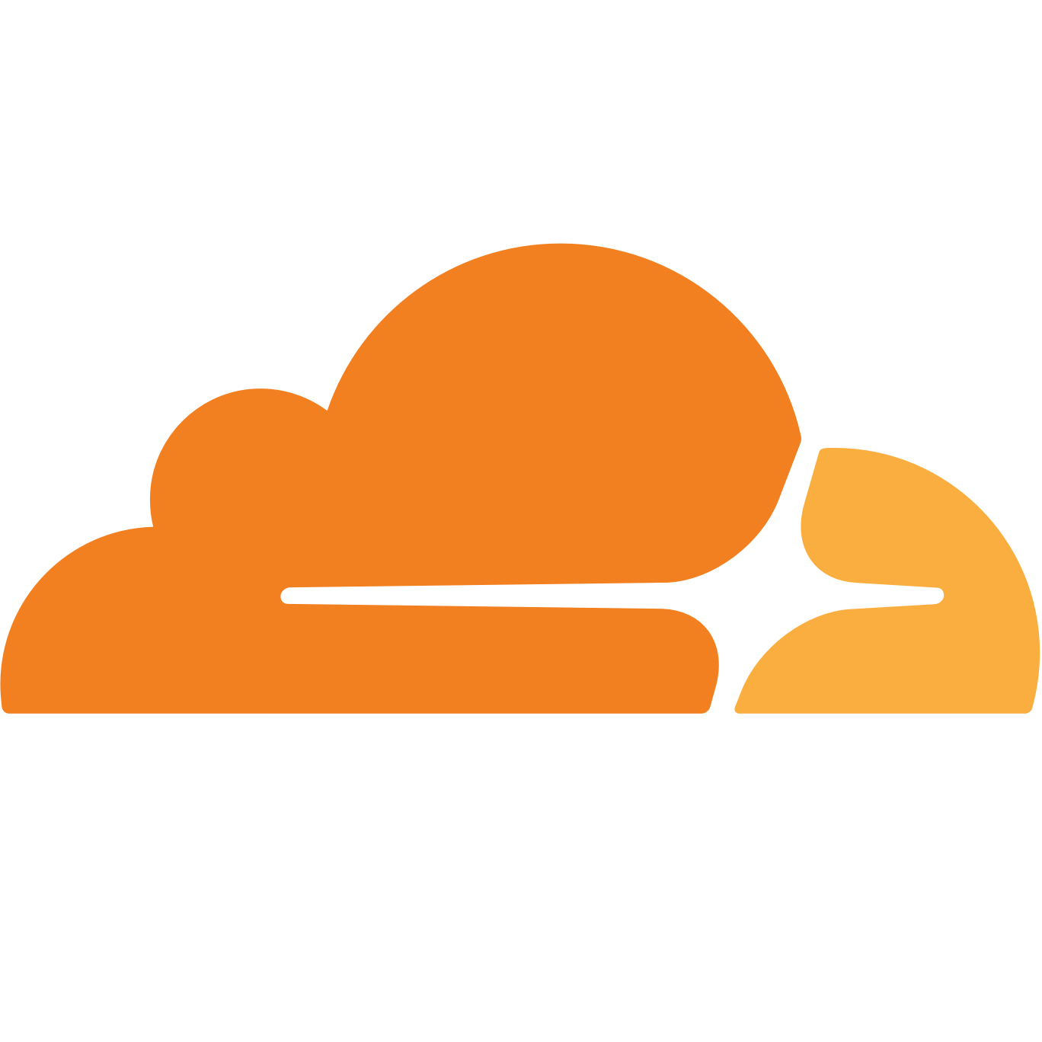
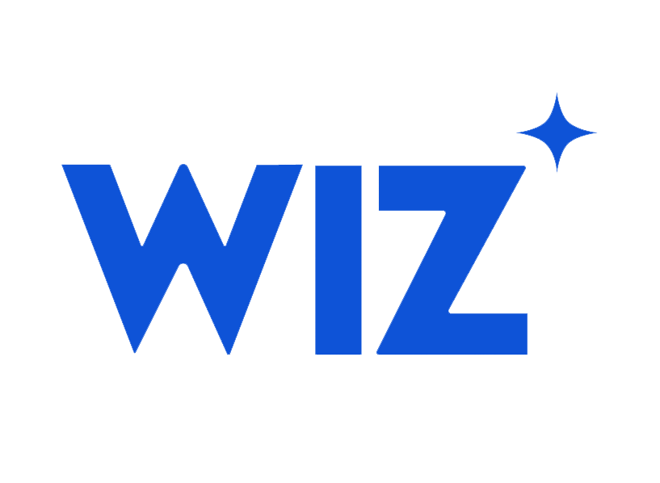
Agentic DevOps
Cloud
CI/CD
Alerts
ITSM
Observability
Security
Developer
Notes:
Agentic integrations could change the industry fundamentally. An open ecosystem approach like that could surface the right insights, to the right person, in the right place.
We should not try to be everything to everyone. Instead, we should bring intelligent observability to the entire digital estate, and it’s made possible with agentic integrations.

Slide 9
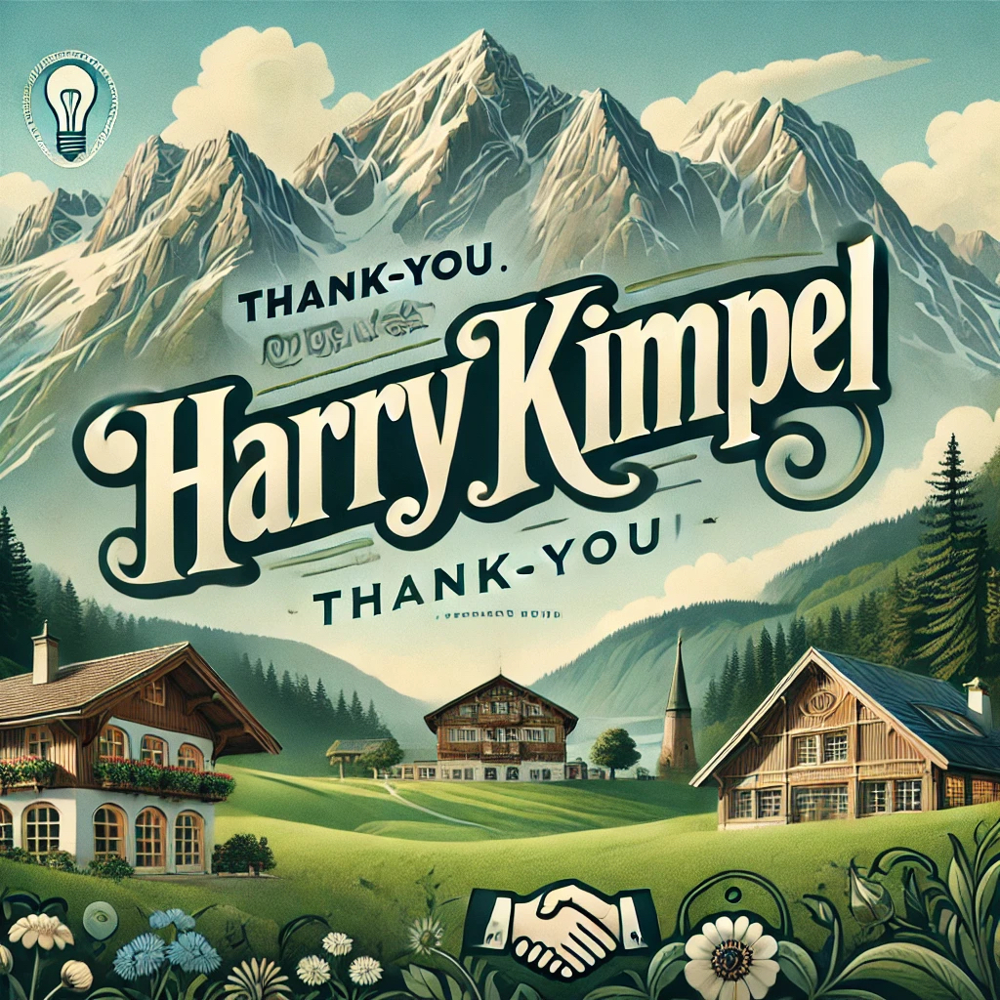
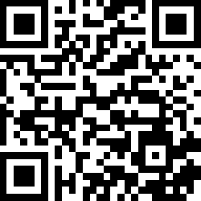
Thank you!
Harry Kimpel
Principal Developer Relations Engineer
New Relic
@harrykimpel
Notes:
Thank you very much for your attention. I am Harry Kimpel and I wish you an exciting Observability Day!

Slide 10
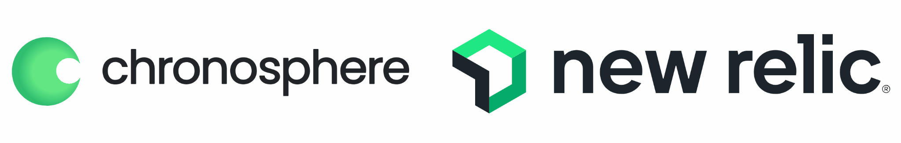
Thank you to our Diamond Sponsors!

Slide 11
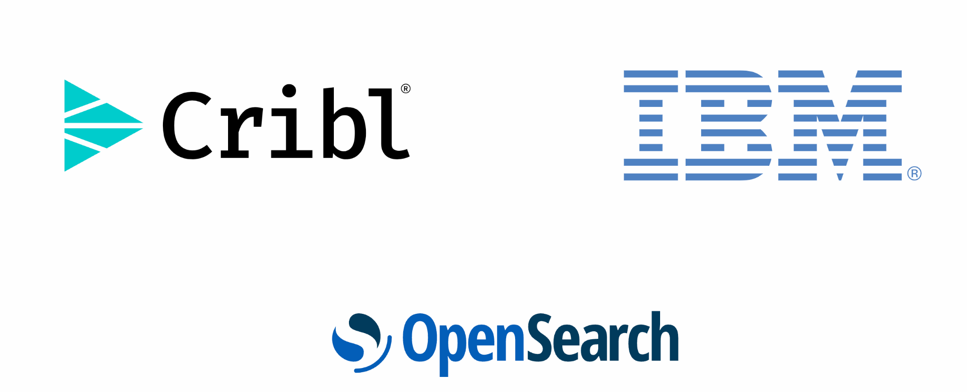
Thank you to our Platinum Sponsors!

Slide 12
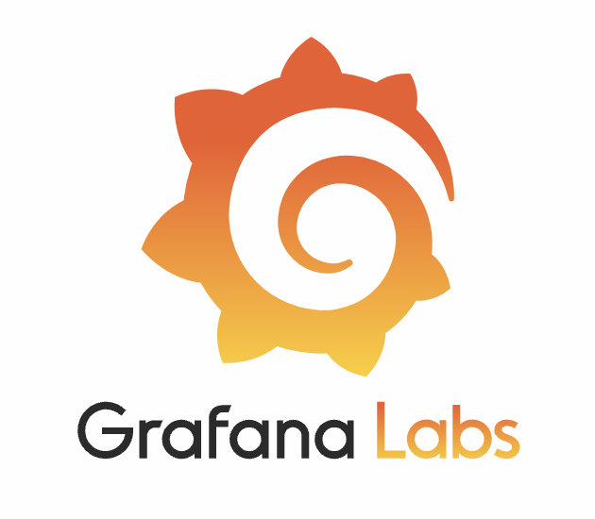
Thank you to our Gold Sponsor!

